Slide 1
GUI Design – User Navigation
Author: Aymen Said
Version 1.9 (Final)
Version History:
1.0 – Creation of the GUI design; added images, panel, and labels (24/02/23)
1.1– Added checkbox, button, text fields and made the GUI design more modern; created this document and added all the attributes (25/02/23)
1.2 – Made another GUI for the signup page (26/02/23)
1.3 – Continued working on the GUI; re-watched lecture 3 online of designing GUI and made a rough design (28/02/23)
1.4 – User Navigation (GUI) has been created; added slide 2 (28/02/23)
1.5 – Removed the background image and replaced it a grey panel; finished designing the 9 GUIs Wireframe; reworked on the GUI rough design again; added a long description of all the GUI pages; re-designed the Login page (01/03/23)
1.6 – Added slide 3, 4 (01/03/23)
1.7 – Added slide 5, 6, 7, 8, 9, 10, 11; refined some of the slides (02/03/23)
1.8 – Added heading/title for each slide (03/02/23)
1.9 – Added ”System Administrator” role onto Combo Box; removed “ID” text field from Add User Page; added “Sign out” button on Welcome Page; re-updated slide 1, 3, 6, 7, 8, 10 (03/02/23)

Slide 2
Start
OVERALL LAYOUT
Login
No
Valid Details?
Yes
Is the user registered?
No
Signup
Yes
Welcome
Refunds
Alerts
Report
User Management
Full Name
Severity
Sales
Add User
Card Number
Description
Stock
Remove User
Ticket
Status
Transactions
Edit User
USD
Last Modified
Commission

Slide 3
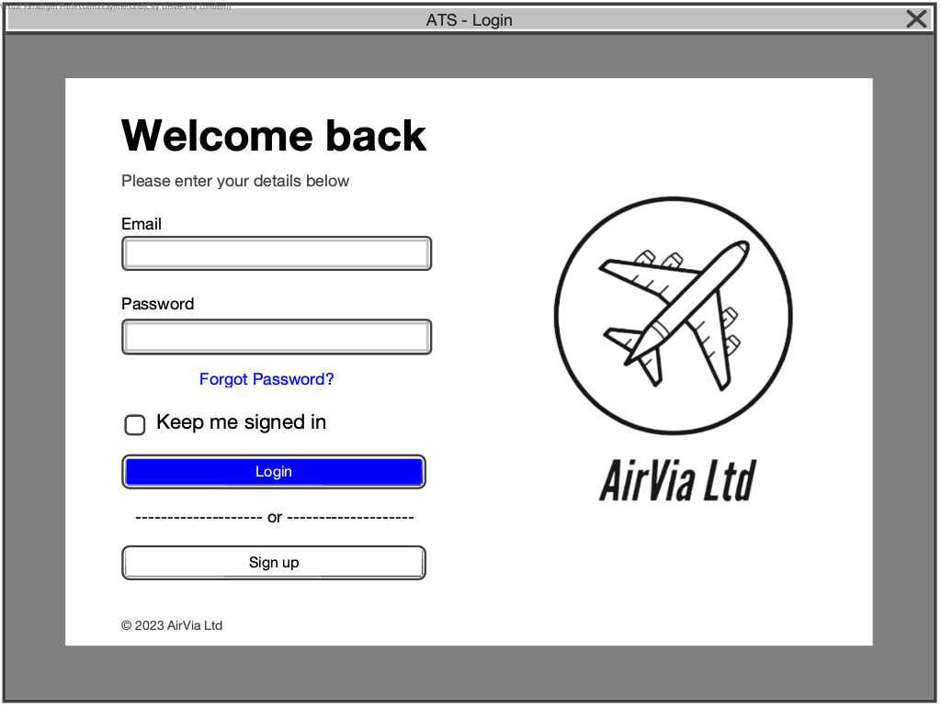
LOGIN PAGE
Change Password Page
No
Valid Details?
Yes
Welcome Page
Sign up Page

Slide 4
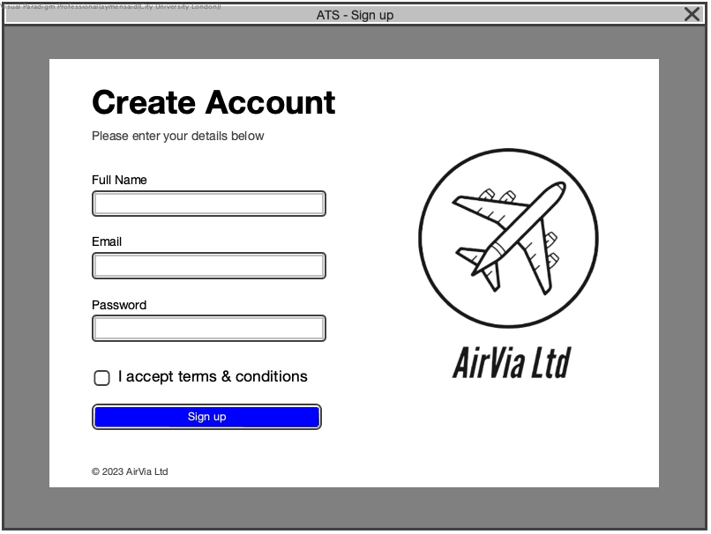
SIGN UP PAGE
Welcome Page

Slide 5
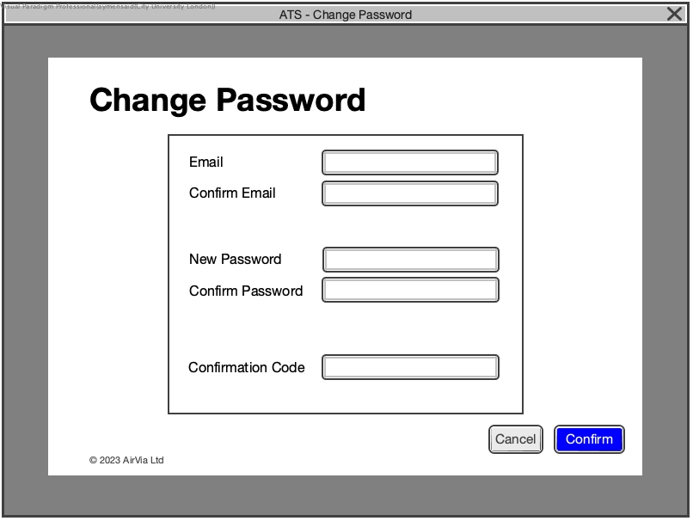
CHANGE PASSWORD PAGE
We will make two versions of the “Change Password GUI” in the development phase.
One version from the “Login Page” (Forgotten your password?) and the other version from the “User Management Page” (Change Password).
Both versions will be identical but will navigate the user back to their previous page once the user have clicked on the “Confirm” button.
Password has been changed
User Management
Was the previous page from Login or User Management?
User
Management
Login
Login

Slide 6
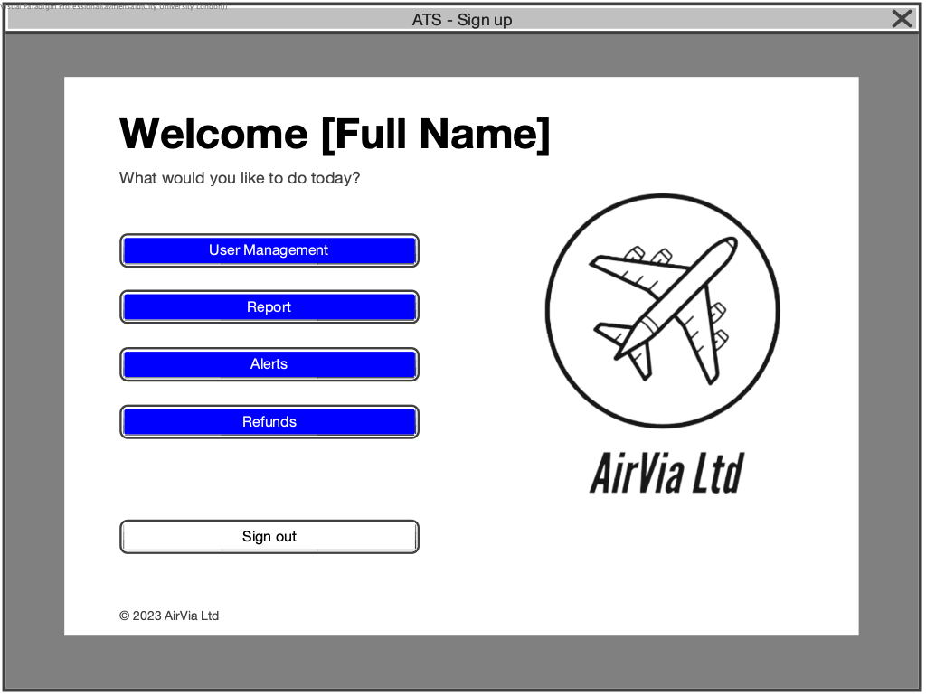
WELCOME PAGE
User Management Page
Report Page
Alerts Page
Refunds Page
Login Page

Slide 7
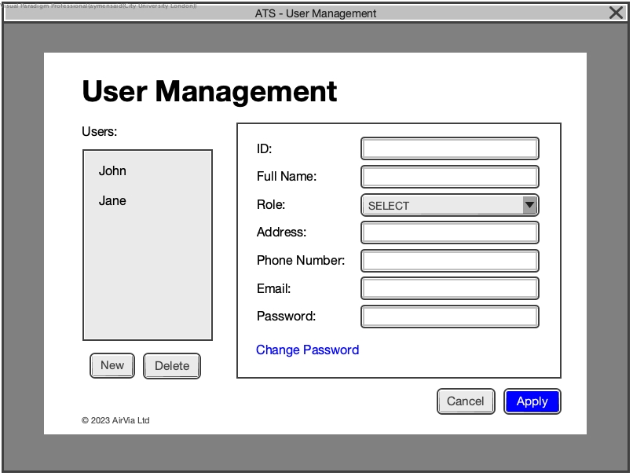
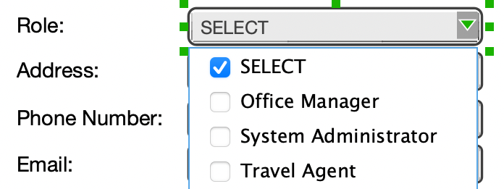
USER MANAGEMENT PAGE
Select a user to remove or edit their details
Change Password Page
User details saved on database
Welcome Page
Add User Page
Removes a selected user from database

Slide 8
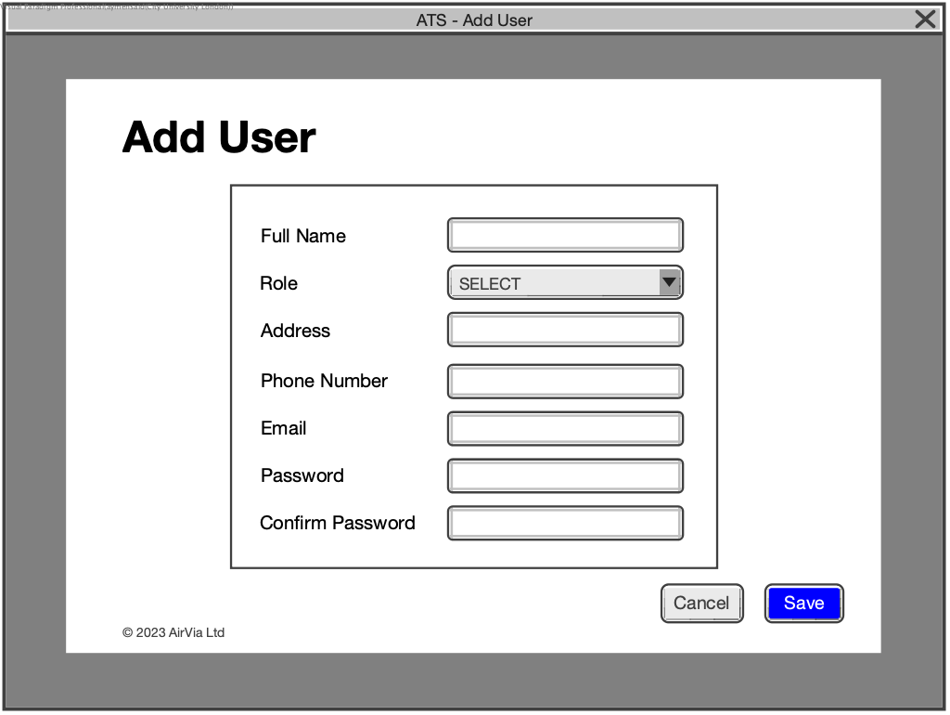
ADD USER PAGE
User details saved on database
User Management Page

Slide 9
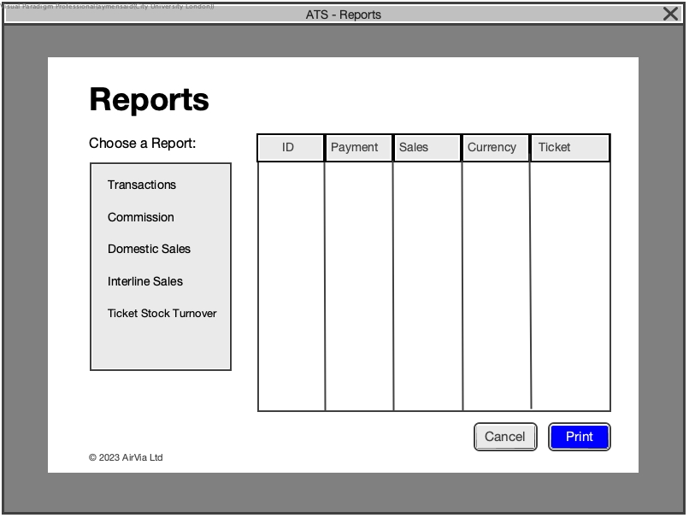
REPORT PAGE
Select a report to view or print their details
Report details is being printed
Welcome Page

Slide 10
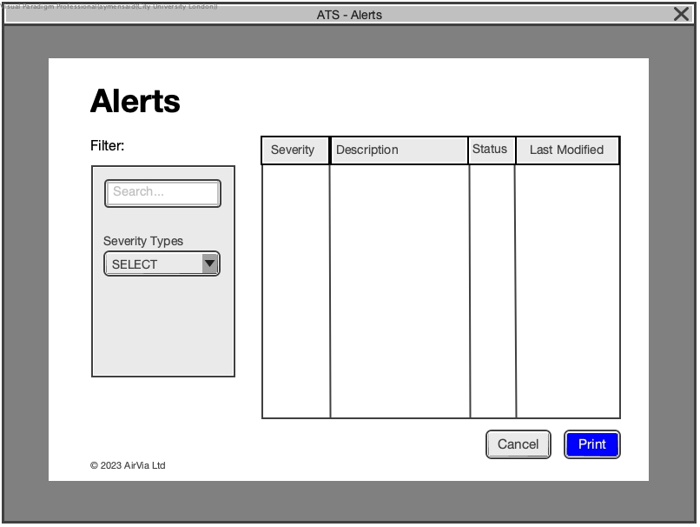
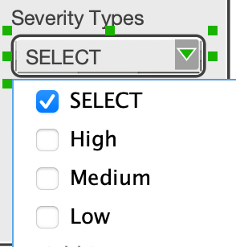
ALERTS PAGE
Shows alerts based on the description you typed
Shows alerts based on a specific severity you chose
Alert details is being printed
Welcome Page

Slide 11
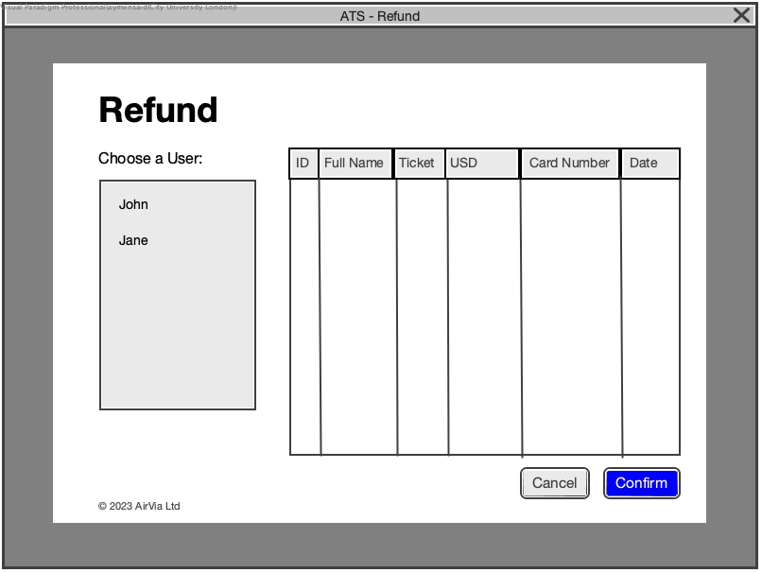
REFUND PAGE
Select a user to proceed the refund
Money has been sent back to the selected user
Outputs: Refund has been proceeded
Welcome Page

